Slide 1
Volume 1_Section 1
Chapter 5:
Personal Protective Equipment
IPC and PS for Healthcare Setting in Ethiopia

Slide 2
Chapter Outline
PPP 5.1: Overview
PPP 5.2: Types, Uses, effectiveness and limitation of PPE
PPP 5.3: Choosing PPE for standard and transmission based precaution
PPP 5.4: Instruction for putting on and removing PPE
PPP 5.5: Type of PPE to prevent transmission of infection during out break

Slide 3
Learning Objective
Describe the benefit of PPE
List the types, uses, effectiveness and limitation of PPE’s
Demonstrate the correct way of donning and removing PPE
PPE’s used in out breaks management.

Slide 4
PPP 5.1:
Overview

Slide 5
Overview
Healthcare workers are confronted each day with the difficult question of how to work safely within the potentially hazardous environment of health care facilities.
The most common occupational risk the healthcare personnel face is due to contact with blood and body fluids during routine works like cleaning, instrument processing and patient care.
This exposure to pathogens increases risk of getting are Healthcare Associated Infections and possible death.
Use of risk appropriate personal protective equipment (PPE) is one of the components of Standard Precautions, which refers to wearing of protective barriers or clothing.

Slide 6
Overview cont’d…
The basic principle behind wearing personal protective equipment is to get physical barrier/protection from pathogenic microorganisms.
PPE includes: gloves, masks/respirators, eyewear (face shields, goggles or glasses), caps, gowns, aprons, boots and other items.
The most effective barriers are made of treated fabrics or synthetic materials that do not allow water or other liquids (blood or body fluids) to penetrate them.
These fluid-resistant materials are not, however widely available because they are expensive.

Slide 7
Overview cont’d…
Lightweight cotton clothes are materials most commonly used for surgical clothing (masks, caps and gowns) and drapes in many countries
Unfortunately, lightweight cotton does not provide an effective barrier because moisture can pass through it easily, allowing contamination.
The state of the PPE is important for it to effectively provide protection.

Slide 8
Overview cont’d…
For example, surgical gowns and drapes have proved to be preventive for impending wound infection only when dry.
When wet, however, clothes act as a wick or sponge to draw bacteria from the skin or equipment up through the fabric that can then contaminate a surgical wound.
To be effective, PPE must be selected, worn and removed correctly.
In participant manual Table 5.0-1 describes how personal protective equipment blocks the spread of Mos.

Slide 9
Overview cont’d…
As a rule, PPE selection should be based on risk assessment.
If there is risk of exposure of patients or health workers then the PPE or combination of PPEs appropriate for the identified risk should be used.
Effectiveness in protection is also dependent on the practice of correct procedures and adherence to rules for wearing (putting-on) and removing (putting-off) of PPE

Slide 10
Overview cont’d…
PPE should be;
Made available close to the point of use for easy accessibility
Stored neatly in a clean / dry area to prevent contamination until required for use.
Preferably single use if reusable there must be a clear policy and SOP for placement in bins after use and removal for laundering and recycling.
Have an SOP for stock ordering and rotation to ensure there is always an adequate supply based on usage and that older items are always used first.
Do not wait for stocks to run out before ordering more.

Slide 11
PPP 5.2:
Types, Uses, Effectiveness and Limitation of PPE

Slide 12
List of PPE and Area of Protection
Types of PPE | Provides protection for
Cap | Hair and Scalp
Google | Eyes
Face Masks | Nose, Mouth and Lower Jaw
Face Shield | Face
Gloves | Hand
Gowns | Upper body, skin and cloth
Apron | Front of the body
Boots | Lower legs and feet
Shoe cover | Shoe

Slide 13
  Caps
Head covers are most commonly used as part of surgical attire in surgical and procedure areas. They are not necessary in most other areas in the HCF.
When used, head covers or caps should be large enough to cover the entire scalp and hair.
Facial hair is also required to be covered for surgical procedures in sterile areas (e.g., in the operating theater) using a facial hair covering.
They can be disposable or made of reusable cloth that can be laundered.
In the surgical and procedure areas, a new clean head covering should be worn each day and changed sooner when soiled with blood or body fluids.
Head covers are not part of routine PPE for Contact, Droplet or Airborne Precautions but are used for during outbreaks for VHF.

Slide 14
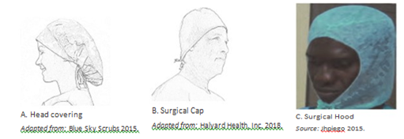
Surgical Head Coverings

Slide 15
Caps cont’d…
Health care works wear caps
  To protect the patient from infection coming from hair and scalp and
  To protect the staff from splashes and exposure to blood.
Patients wear caps
  To keep the sterile field during invasive procedure

Slide 16
  Protective Eye Wear
There are four different types of eye protection that are effective in preventing infection in health care facilities
  Goggles
  Safety Glass
  Masks attached shield
  Face shield

Slide 17
Protective Eye Wear cont’d…
Eye protection should be comfortable, allow for sufficient peripheral vision (i.e., the area that is visible outside the central area of focus), and must be adjustable to ensure secure fit.
Compared to older styles of goggles, newer styles may provide better indirect airflow properties to reduce fogging, provide better peripheral vision, and offer more size options for fitting goggles to different HCWs.
Eye wear protects the staff during accidental splash of blood or other body fluid by covering the eyes.
Note: Personal eye glasses and contact lenses are NOT considered adequate eye protection.

Slide 18
Protective Eye Wear cont’d…
Masks and eyewear should be worn when performing any task where an accidental splash into the face could occur (e.g. performing cesarean section, vaginal delivery or cleaning instruments) when giving care to patients with droplet precautions.
If face shields are not available, goggles or glasses and mask can be used together.
If reusable eye/face protection is used, it should be decontaminated in accordance with the manufacturer’s guidelines.
Hands should always be decontaminated after removing the equipment.

Slide 19
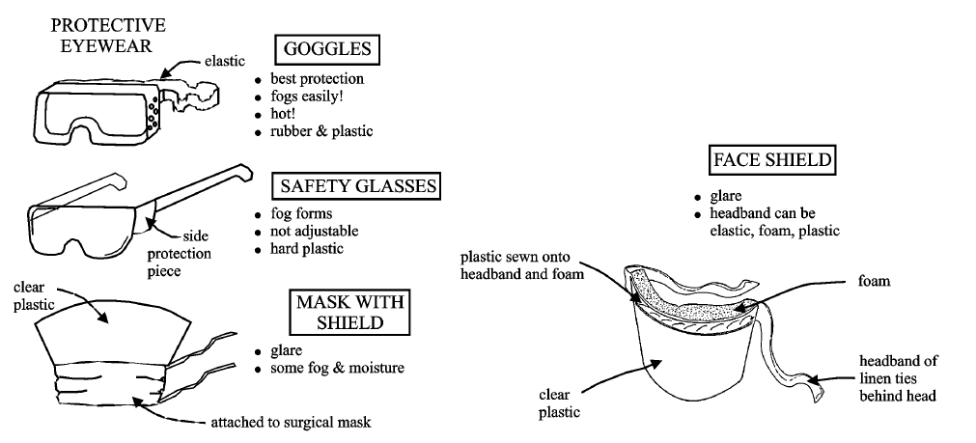
Different types of Eye Protection Equipment’s

Slide 20
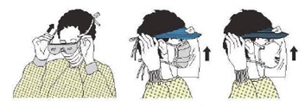
How to put on protective eyewear
Put on eye protection after putting on the isolation gown and mask (if used) but before putting on gloves

Slide 21
How to take off protective eyewear
Removal of face shield, goggles, and mask can be performed safely after gloves have been removed).
The ties, ear pieces, and/or head band used to secure the equipment to the head are considered “clean” and safe to touch with bare hands.
If the ties, ear pieces, and/or head band are found to be contaminated, they should be removed using gloved hands and the skin/face should be rinsed using ample running water and soap.
The front of a mask, goggles, and face shield is considered contaminated.

Slide 22
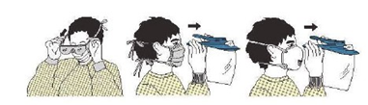
Taking off Eye Protection

Slide 23
  Masks
There are many different types of masks used to cover the mouth and nose.
Masks made from cotton or paper are comfortable but are not fluid-resistant (do not protect from splashes) and are not an effective filter to prevent inhalation of microorganisms transmitted via droplet nuclei (≤ 5 µm). Masks made from synthetic materials provide protection from large droplets (> 5 µm) spread by coughs or sneezes.

Slide 24
  Masks
They may be more difficult to breathe through than cotton or paper masks.
The use of masks during patient care is part of Standard Precautions when there is a potential for splashes or droplet transmission and is part of Droplet Precautions.

Slide 25
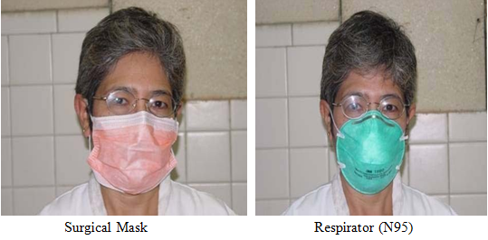
Types of Masks frequently used by health care workers

Slide 26
Types of Masks
Surgical masks:
  Regulating bodies (such as The United States Food and Drug Administration [FDA], the European Union, and WHO) require surgical masks to have fluid-resistant properties.
Procedure/isolation masks:
  These are not regulated and they do not have any specifications for their manufacture.

Slide 27
Surgical Masks
Masks should be large enough to cover the nose, the lower part of the face, the jaw and all of the facial hair.
They are worn in an attempt to retain/confine moist droplets expelled as health workers or surgical staff speaks, cough or sneeze.
Equally important, is its protective function against accidental splashes of blood or other contaminated body fluids on the health workers’ nose or mouth.
This preventive function, however, would not be effective unless the masks are made of fluid-resistant materials.
When removing, one should handle the masks by the strings, do it with great care as the center of the mask is the most contaminated site of all other parts

Slide 28
Respirators
This are special types of masks called particulate respirators worn by healthcare personnel for protection against inhalation exposure to airborne infectious agents that are < 5μm.
These include infectious droplet nuclei from patients with Micobacterium tuberculosis, Variola virus (smallpox), SARS-CoV, and dust particles containing infectious particles such as spores of environmental fungi (e.g. Aspergillus sp.).

Slide 29
Respirators cont’d…
Respirators should be worn when filtering inhaled air is deemed important. These articles contain multiple layers of filter material and fit into the face tightly allowing no air leaks around the mask when breathing.
The N95 disposable particulate and air purifying respirator is the type used most commonly by healthcare personnel.
Other respirators used include N-99 and N-100 particulate respirators; powered air-purifying respirators with high efficiency filters; and non-powered full-face piece electrometric negative pressure respirators

Slide 30
  Gowns
Gowns should fully cover the torso of the HCW, fit comfortably over the body, and have long sleeves that fit snuggly at the wrists.
There are three types of protective gowns used in health care facilities:
  Isolation gowns,
  Surgical gowns, and
  Coverall suits

Slide 31
Isolation gowns
Should be long-sleeved, fluid-resistant, single- use, and preferably disposable.
Isolation gowns are designed to prevent contamination of HCWs’ arms, exposed areas of the body, and clothing from blood and body fluids and other potentially infectious material.
Note: Isolation gowns should be worn in combination with gloves and other PPE, as recommended.

Slide 32
Surgical gowns
Should sterile and preferably fluid-resistant, with sleeves that either taper gently toward the wrists or end with elastic or ties around the wrists.
Large, droopy sleeves are not recommended because they can cause accidental contamination.
Surgical gowns are used during surgery or procedures to protect patients and the sterile field from microorganisms from blood and other body fluids (e.g., amniotic fluid) present on the HCW’s clothing, the front of the HCW’s body, and the HCW’s arms.

Slide 33
Surgical gowns cont’d…
When the surgical gowns are put on, the cuffs of sterile surgical gloves should completely cover the end of the sleeves of the gowns.
Lightweight cloth or paper gowns are not recommended because they offer little protection against moisture, which can easily pass through, allowing the passage of microorganisms.
If a cloth or paper gown is used, always wear a plastic apron under/over it.

Slide 34
Coveralls
Are full-body suits made from materials that are lightweight, breathable, and impermeable to liquids.
These are to be worn by all HCWs who work in isolation areas for treating highly infectious diseases (e.g., VHF).
They are designed to go over a scrub suit and create a barrier to eliminate or reduce contact exposure to blood, body fluids, and highly infectious microorganisms.
Coveralls without attached hood and with thumbholes are recommended.

Slide 35
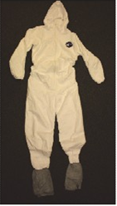
Coverall Suit

Slide 36
When to wear gowns:
The type of gown to use is based on the type of patient interaction, including the anticipated degree of contact with infectious material and the potential for blood and body fluid penetration of the barrier and the type of task to be carried out by the HCW:
  During Standard Precautions, an isolation gown (with gloves) is worn if blood or body fluid contact, spills, or splashes onto clothing is anticipated.
  During Contact and Droplet Precautions, an isolation gown (with gloves) is used to prevent transmission of an infectious agent that cannot be prevented by Standard Precautions alone.
  During surgical procedures, deliveries, or other aseptic procedures, a sterile surgical gown is worn to protect the sterile field and the clothes of the scrub team or those performing the procedure.

Slide 37
How to wear and remove gowns
Full coverage of the arms and body front, from the neck to the mid-thigh or below, will ensure that clothing and exposed areas of the upper body are protected.
Isolation gowns are usually the first piece of PPE to be put on.
HCWs should remove isolation gowns before leaving the patient care area to prevent possible contamination of the environment outside of the patient care area.

Slide 38
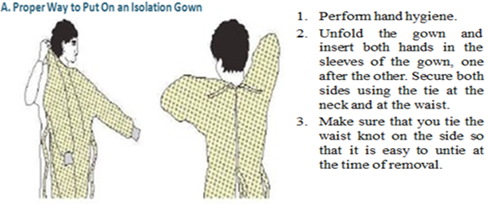
How to put on isolation gown

Slide 39
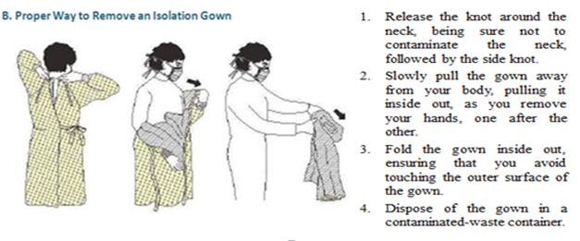
How to remove isolation gown

Slide 40
  Plastic Apron
It is used to protect clothing or surfaces from contamination.
Reusable aprons which are made of rubber or plastic provide a waterproof barrier along the front of the personnel’s body.
Thus, it should also be worn during cleaning and procedures with likelihood of splashes or spillage of blood, body fluids, secretions or excretions (e.g. when conducting deliveries).
Disposable water-proof aprons are also available for clinical use.

Slide 41
  Gloves
Healthcare Workers Wear Gloves for the Following Three Reasons:
  To reduce the risk of acquiring infections to the staff from patients
  To reduce the risk of transmitting microorganisms including skin flora from provider to clients/patients
  To reduce contamination of the hands of the staff by microorganisms which are transmissible from one patient to another (cross-contamination).

Slide 42
Types of gloves
Surgical Glove - should be used when performing invasive medical or surgical procedures.
Clean Examination Gloves - provide protection to healthcare workers when performing many of their routine duties. These gloves can be used whenever contact with mucous membrane and non-intact skin is anticipated (e.g. during medical examinations and procedures such as pelvic examination).
Utility or Heavy-Duty Gloves - should be worn when processing instruments, equipment and other items, for handling and disposing contaminated waste, and when cleaning contaminated surfaces.

Slide 43
When to Wear Gloves
Depending on the situation, surgical gloves, clean examination or utility gloves should be worn by all staff where:
  There is a chance of hands coming in contact with blood or other body fluids, mucous membranes or none intact skin;
  They perform invasive medical procedures (e.g. inserting vascular devices such as peripheral venous lines); or
  They handle contaminated waste items or touch contaminated surfaces.

Slide 44
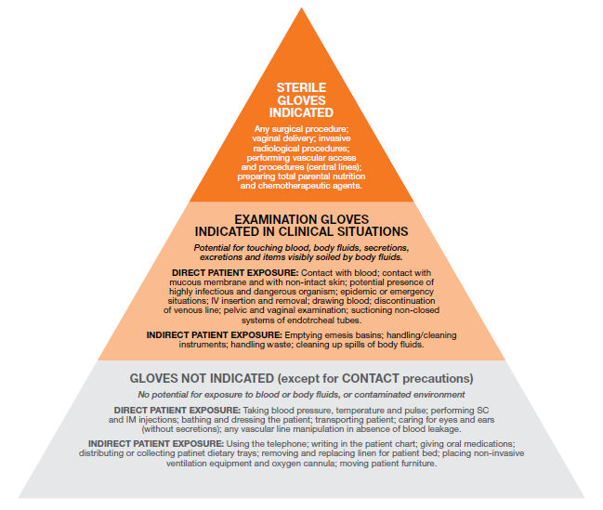
The Decision Pyramid –
When to and not to wear gloves
Image from WHO (2009); Hand Hygiene Why, How and When

Slide 45
When to Use Double Gloves
Even the best quality, new latex rubber surgical gloves may leak up to 4% of the time.
Moreover, it was found that latex gloves gradually become weaker and lose their intactness especially when exposed to fat on surfaces of wounds.
Note: The acceptable “leak rate for new surgical and examination gloves designated by regulatory agencies is up to 4%.
Although double gloving is of little benefit in preventing exposure to blood in case of needle sticks or other similar injuries, it may decrease the risk of blood-hand contact.

Slide 46
Health care providers should Double Glove when:
The procedure involves coming in contact with large amounts of blood or other body fluids (e.g. vaginal deliveries and cesarean sections).
Performing orthopedic procedures in which sharp bone fragments, wire sutures and other sharp edged materials are likely to be encountered.
Performing surgical procedures lasting more than 30 minutes. (Most surgeons, these days use double glove routinely).

Slide 47
When to use elbow length gloves:
Elbow length gloves should be used during vaginal deliveries and cesarean sections where the chance of coming in contact with blood is 25% and 35% respectively.
Elbow length gloves are also recommended to be used during performing procedures like manual removal of placenta and any other procedure where contact with a large volume of blood or body fluids is likely.
This kind of glove is generally meant to give protection to the hands including the forearms.

Slide 48
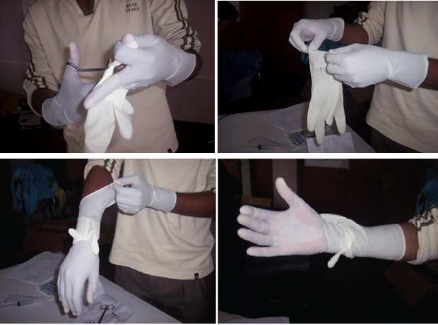
How to make Elbow Length Gloves

Slide 49
How to use gloves
Although the effectiveness of gloves in preventing contamination of the healthcare workers’ hands has been repeatedly confirmed (Tenorio et al., 2001), wearing gloves does not replace the need for hand washing.
The truth is that even the best quality latex surgical gloves may have small and unnoticeable defects; they may be torn during use; and the hands can become contaminated during removal.
Note: Practice of hand hygiene, coupled with the use of protective gloves, is a key component in minimizing the spread of disease.

Slide 50
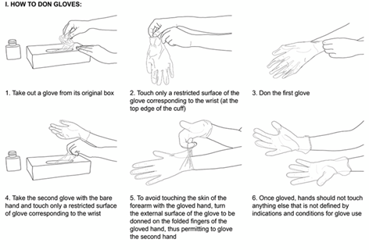
How to don examination gloves
Wash hands before donning of gloves

Slide 51
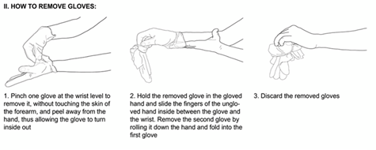
How to remove examination gloves
Wash hands after removing gloves

Slide 52
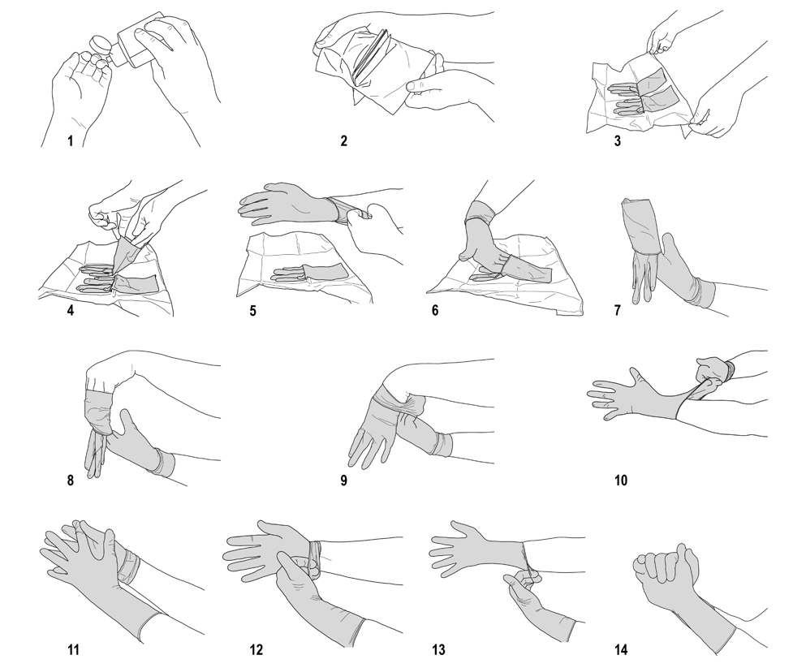
Procedure for wearing Sterile Gloves
Wash hands before donning of gloves

Slide 53
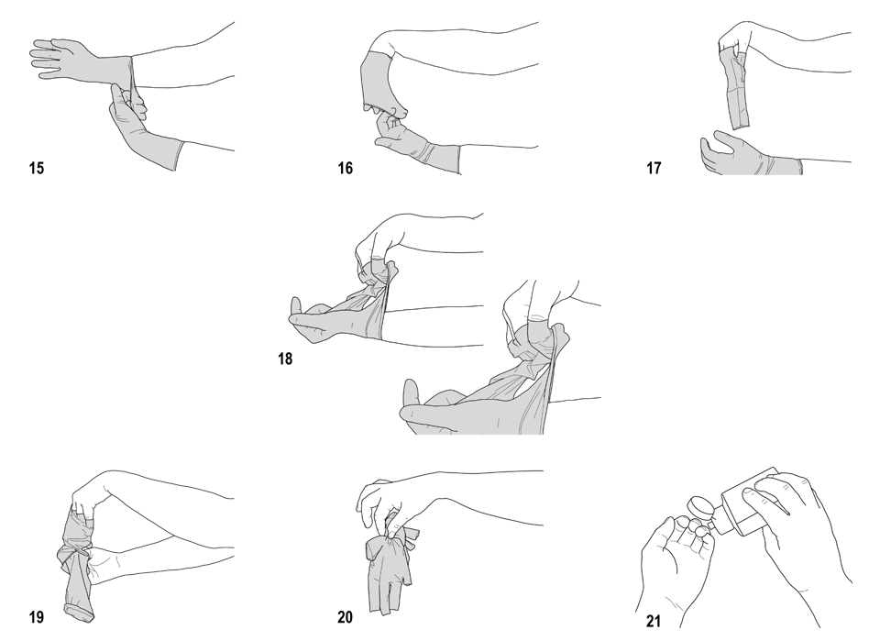
How to remove (doff) sterile gloves
Wash hands after removing gloves

Slide 54
Donning surgical gloves for surgical intervention
Donning surgical sterile gloves at the time of a surgical intervention follows the same sequences except that:
  It is preceded by a surgical hand preparation.
  Donning of the gloves is performed after putting on the sterile surgical gown.
  The opening of the first packaging (non-sterile) is done by an assistant.
  The second packaging (sterile) is placed on a sterile surface and then used for the intervention.
  Gloves should cover the wrists of the sterile gown.

Slide 55
Some Do’s about Gloves
Do wear the correct size gloves, A poorly fitting glove can limit your ability to perform the task and may get damaged easily
Do change surgical gloves periodically (every 45 minutes) during long cases as the protective effect of latex gloves decreases with time and in apparent tears may occur.
Do keep fingernails trimmed moderately short (less than 3mm beyond the finger tip) to reduce the risk of tears.
Do pull gloves up over cuffs of gown (if worn) to protect the wrists.
Do use water-soluble hand lotions and moisturizers often to prevent hands from drying, and cracking due to frequent hand washing and gloving.

Slide 56
Some Don’ts about Gloves
Don’t use oil-based hand lotions or creams, because they will damage latex surgical and examination gloves.
Don’t use latex gloves if you or the patients have an allergy to latex.
Don’t store gloves in areas where there are extremes of temperature (e.g. direct sunlight, near the heater, air conditioner, ultraviolet light, and X-ray machine). These conditions may damage the gloves (cause breakdown of the material they are made of), thus reducing their effectiveness as a barrier.
Don’t reprocess gloves that are cracked or have detectable holes/tears.
Don’t reprocess examination gloves for reuse.
Re-process utility gloves by immersing them in a 0.5% Chlorine solution briefly, remove gloves by inverting them and then soak them in the 0.5% Chlorine solution for 10 minutes before washing and drying them for reuse.

Slide 57
Cont’d…
Note:
A separate pair of gloves must be used for each client to avoid cross-contamination or when moving from one site to another site on the same patient (i.e. from respiratory care to a dressing change).It is preferable to use new and single use (disposable) gloves only.

Slide 58
  Footwear
It’s worn to protect the feet from injury by sharp or heavy items or fluids that may accidentally spill over, drip, or even pour out upon them. All footwear should have closed toes, low heels, and nonskid soles.
Rubber boots or leather shoes provide the best protection.
They must be kept clean.
For this reason, sandals and other open-toe shoes or shoes made of soft materials are not acceptable.
Shoe covers are unnecessary, if clean and sturdy shoes are available for dedicated use only in the surgical area.
However, Shoe covers may be needed to minimize contamination from and of shoes.
Shoe covers are not meant to prevent transmission of bacteria from the floor but rather prevent contamination of shoes with blood and body fluids.

Slide 59
  PPP 5.3:
  Choosing PPE for Standard and Transmission-based Precaution

Slide 60
Choosing PPE
For the purpose of Standard Precautions, PPE are chosen based on the risk of exposure to blood or body fluids during patient care.
The choice could be simply a pair of non-sterile gloves if touching contaminated surfaces or gown, gloves, mask and eye protection if extensive splashing is expected.
For the purpose of transmission-based precautions septic items of PPE are designated for each type (e.g. only an N95 respirator if providing care to a suspected case of TB, as Airborne Precautions do not require use of gown or gloves).

Slide 61
PPP 5.4:
Instruction for putting on and removing PPE

Slide 62
Instruction for putting on and removing PPE
Putting on and removing PPE in the proper order and manner is just as important as wearing PPE.
Failure to properly put on or remove PPE could lead to exposure to or lack of protection against infectious agents.
The order of putting on PPE and removing PPE depends upon the purpose for which the PPE is being used.

Slide 63
Sequence for Putting on PPE for Standard and Transmission-based Precautions
Put on protective boots or shoe covers (if needed).
Perform hand hygiene.
Put on a gown.
Put on a procedure mask/N95 respirator.
Put on goggles or a face shield.
Lastly, put on gloves.

Slide 64
Sequence for removing PPE for Standard and Transmission-based Precautions
Remove gloves.
Remove goggles/ face shield by the “clean” head band or ear pieces.
Remove the gown.
Remove the mask or respirator.
Dispose of single-use and reusable PPE in designated containers.
Remove shoe covers or boots (if used) before leaving the area.
Perform hand hygiene.

Slide 65
Sequence for Putting on PPE for Sterile Surgical Procedures in the Operating Theater
Change from street clothes to a clean scrub suit (one that has been processed in the health care facility laundry). Remove all jewelry.
Put on non-skid, low-heel shoes with closed toes and back, rubber boots, or shoe covers when there is a risk of gross contamination with blood or body fluids.
Perform hand hygiene.
Put on a plastic apron if the sterile surgical gown is not fluid-resistant.
Put on a surgical head cover (and facial hair cover, if needed) to ensure that hair on the head (and beard) are fully covered.

Slide 66
Sequence for Putting on PPE for Sterile Surgical Procedures in the Operating Theater cont’d…
Put on a surgical mask, one that fits well and fully covers the mouth and the nose.
Put on appropriate sized, well-fitting goggles or a chin-length face shield.
Perform a surgical hand scrub using soap and water and ABHR (see Chapter 3: Hand Hygiene).
Put on a sterile surgical gown without contamination.
Lastly, put on sterile surgical gloves without contamination.

Slide 67
  Sequence for Removing PPE following Sterile Surgical Procedures in the Operating Theater
Remove the gloves following the recommended steps and dispose of in a waste container; do not reprocess or reuse the gloves.
Remove the gown, avoid touching the outer side of the gown, and dispose of in a waste container (if a single-use gown) or place the used gown in a container for processing later.
Remove the plastic apron, if one was used, and dispose of in a waste container (if a single-use apron) or place the used apron in a container for processing later.
Remove eye protection.
Remove the surgical mask.
Perform hand hygiene.

Slide 68
  Sequence for Removing PPE following Sterile Surgical Procedures in the Operating Theater
These steps will be performed at the end of day unless any item becomes soiled.
Remove the head cover (and facial cover).
Remove shoe covers (if worn).
Remove shoes.
Remove scrub suit.
Lastly, perform hand hygiene.

Slide 69
PPP 5.5:
Types of Personal Protective Equipment used to Prevent Transmission During Disease Outbreak

Slide 70
List of Personal Protective Equipment
PPE recommended by the World Health Organization (WHO) for HCWs who provide care and treatment to VHF (E.g. Ebola) patients includes:
  Fluid-resistant coverall or gown:
    Without an attached hood
    With thumb holes or loops
  Waterproof apron
  Waterproof boots

Slide 71
List of Personal Protective Equipment Cont’d…
  Fluid-resistant isolation mask with a design that does not collapse against the mouth
  Face shield
  Respirator—required when performing aerosol-generating procedures is anticipated
  Head cover that covers head and neck (separate from the gown or coverall)
  Double gloves with cuffs to mid-forearm (nitrile preferred over latex)

Slide 72
Summery
The use of PPE is recommended to protect HCWs from hazards encountered during their regular, daily duties.
An adequate supply of PPE should be available for use at the point of care.
In situations with limited resources, PPE should be prioritized to provide, at a minimum, implementation of Standard Precautions.
Staff should be educated and trained on the indications for PPE, the benefits and limitations of specific PPE, and the correct procedure for putting on, wearing, and removing PPE so that PPE can be used effectively and efficiently.

